Slide 1
Image Noise
Gaussian noise
Gaussian noise refers to a noise signal with a PDF equal to that of the normal, or Gaussian distribution, that is added to an image. It is usually introduced during the acquisition and/or transmission process. It can be reduced using spatial filtering methods which may, unfortunately, blur image edges and details.
For this exercise, you are tasked to corrupt an image with Gaussian noise.
The algorithm takes as input an image and the mean and variance of the Gaussian distribution, creates a random Gaussian noise signal, adds it to the original image and returns the noise image. Then the original image is displayed alongside the noise one.

Slide 2
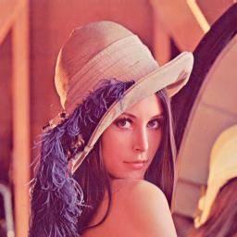

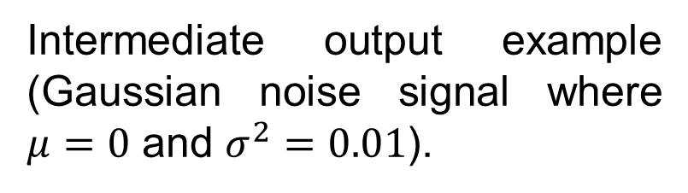
Image Noise
Gaussian noise
Intermediate output example (Gaussian noise signal where $μ=0$ and $σ^{2}=0.01$).
Input example.

Slide 3
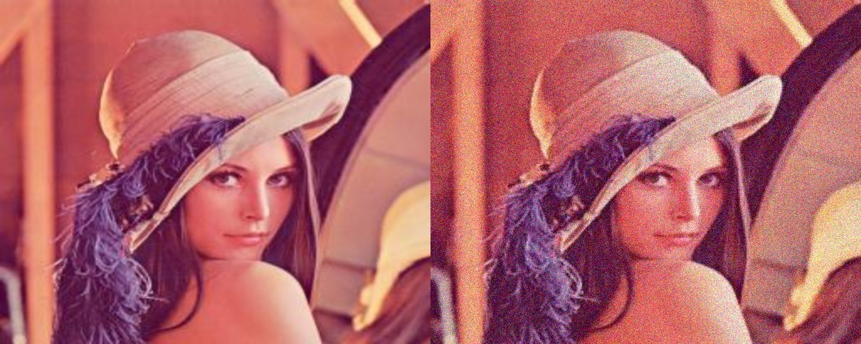
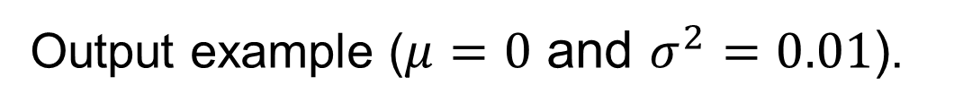
Image Noise
Gaussian noise
Output example ($μ=0$ and $σ^{2}=0.01$).

